Slide 1
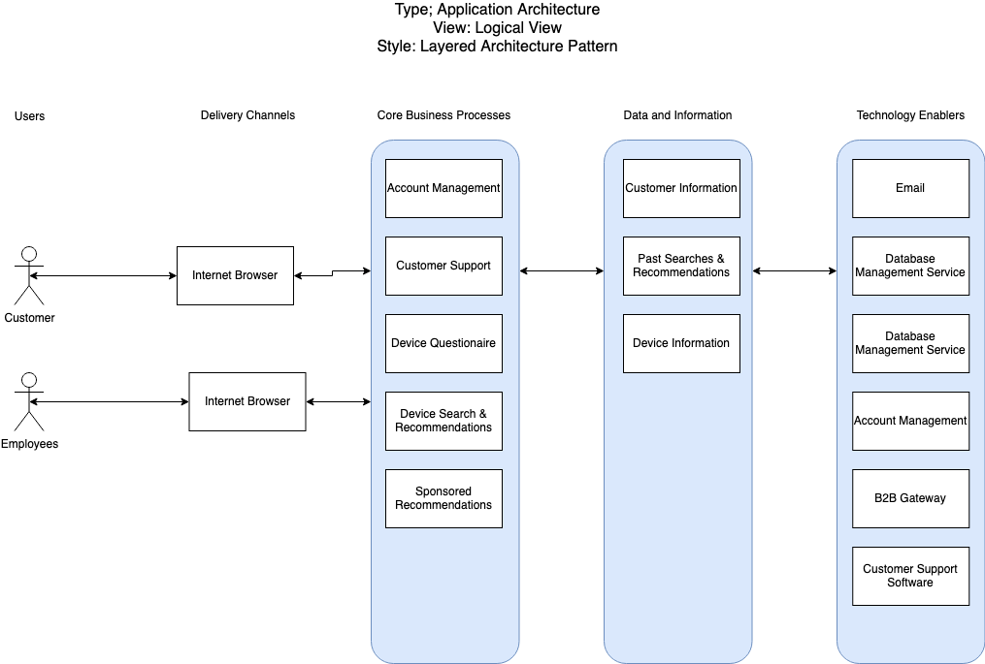
Tech Selector Architecture Diagram

Slide 2
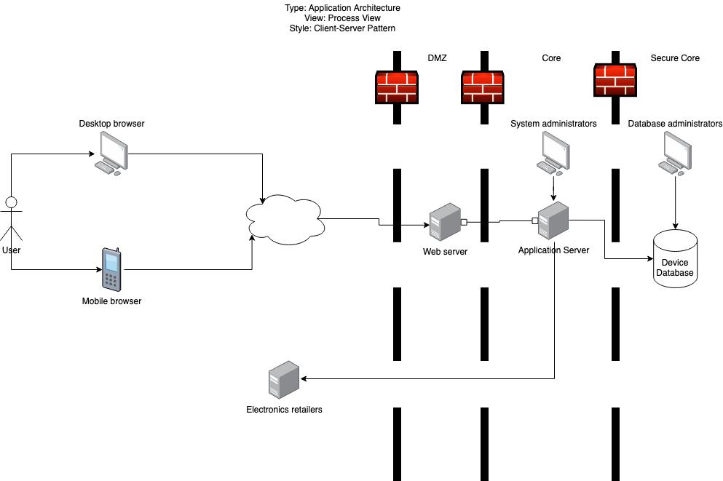
Tech Selector Architecture Diagram

Slide 3
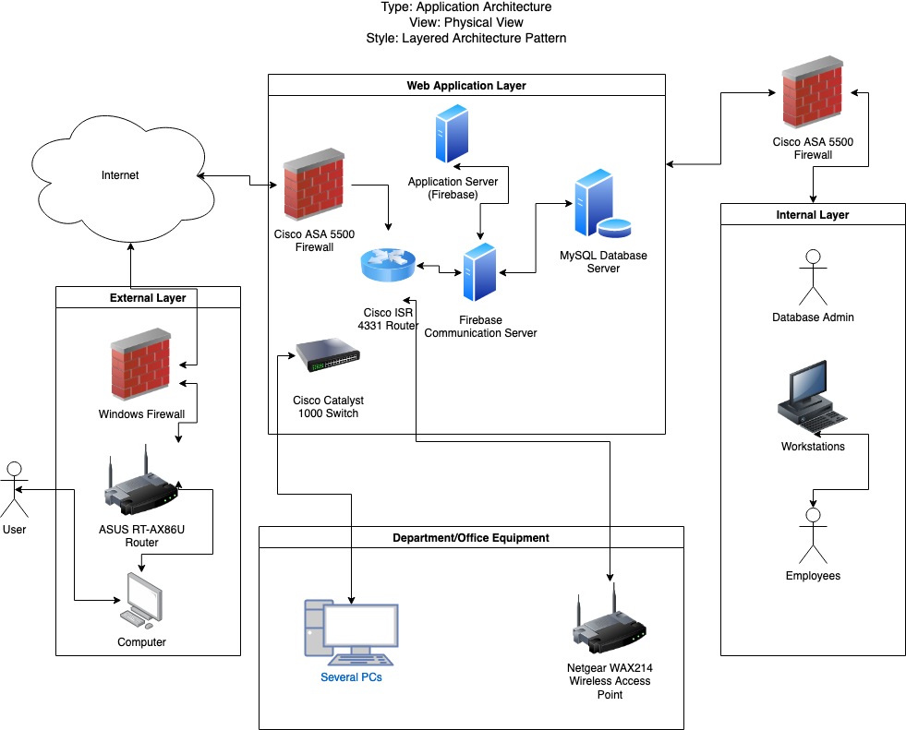
Tech Selector Architecture Diagram

Slide 4
Revisions
Removed “customer support” and duplicate “database management service” entries from the layered logical view

